Slide 1
Data Structures
Lecture 02

Slide 2
Topics to be covered…
Last week, we learned about the "what" (ADTs) and the "how" (Data Structures). Today, we learn how to choose the best "how."
Hour 1: The Need for Speed
Why does performance matter?
Why a stopwatch is a bad tool for measuring code speed.
A better way: Counting operations.
Hour 2: Introducing the Language of Performance - Big O
Asymptotic Analysis: Focusing on what matters.
Defining Big O Notation.
Rules for simplifying complexity.
Hour 3: Common Complexity Classes
From blazing fast O(1) to dangerously slow O(2ⁿ).
Analyzing real code examples for each class.
Best, Average, and Worst-Case scenarios.

Slide 3
Recap: ADTs vs. Data Structures
Remember the List ADT? It defines operations like add, remove, and get.
We can implement this ADT with different Data Structures:
An Array
A Linked List (we'll cover this soon!)
The Central Question: If we have multiple ways to implement an ADT, which one is better? Which one is more efficient?

Slide 4
Why Does Efficiency Matter?
It's not just about showing off. Efficiency has real-world consequences:
User Experience: No one wants to wait 10 seconds for a search result to appear. A slow website or app loses users.
Scalability: An algorithm that's fast for 100 users might take hours for 1 million users. Google Search has to be incredibly efficient to handle billions of queries.
Cost: In cloud computing, you often pay for CPU time. A more efficient algorithm can directly save a company thousands or millions of dollars in server costs.

Slide 5
How Not to Measure Efficiency: The Stopwatch Method
A naive approach: "Let's just time the code!"
start_time = clock()
run_my_function()
end_time = clock()
duration = end_time - start_time
Why is this a terrible idea?
Machine Dependent: The code will run faster on a supercomputer than on your laptop.
Language/Compiler Dependent: The same algorithm written in C++ will likely run faster than in Python.
Input Dependent: Searching for the first item in a list is faster than searching for the last. Which input do you test?
It tells you the speed for one specific run, not the general behavior of the algorithm.

Slide 6
A Better Way: Count the Operations
Let's be scientific! We can analyze the algorithm itself, independent of hardware or language.
The idea is to count the number of fundamental steps (operations) the algorithm performs.
Operations:
Assignments (x = 5)
Comparisons (x < y)
Arithmetic operations (+, -, *, /)
Accessing an array element (arr[i])
Our goal is to express the number of operations as a function of the input size, n.

Slide 7
Example: Finding the Maximum Value in an Array
Let's analyze this simple function. Let n be the size of the array data.
int findMax(int[] data) { int max = data[0]; // 1 assignment for (int i = 1; i < data.length; i++) { // 1 assignment, n comparisons, n-1 increments if (data[i] > max) { // n-1 comparisons max = data[i]; // ??? assignments } } return max; // 1 return }
Counting is complicated! The number of assignments in the if block depends on the data.
This is too detailed and messy. We need a way to see the "big picture."

Slide 8
Asymptotic Analysis & Big O Notation
We don't care about the exact number of operations. We care about how the number of operations grows as the input size (n) gets very large.
Analogy: Planning a Cross-Country Road Trip 🚗
Total Cost = (Cost of Gas * Kilometers) + Cost of Snacks
For a short trip to the next town, the cost of snacks might be a big part of the total.
For a 5,000 km trip, the cost of snacks is insignificant. The cost is dominated by the per-kilometer gas price.
In algorithm analysis, n is the distance. We want to find the term that dominates the cost when n is huge.

Slide 9
Introducing Big O Notation
Big O notation is the language we use to describe the long-term growth rate of an algorithm.
It describes the worst-case scenario.
Formally, if we say a function is O(f(n)), it means its growth rate is less than or equal to the growth rate of f(n).
Think of it as an upper bound, or a guarantee: "My algorithm will never be slower than this growth rate."

Slide 10
The Rules of the Game: Simplifying
To find the Big O complexity, we simplify our operation-counting function using two key rules. Rule 1: Keep the Fastest-Growing Term.
As n gets large, the term with the highest exponent dominates.
f(n)=n2+5n+100
When n=1,000, n2=1,000,000, while 5n=5,000. The n2 term is what matters.
So, this function has a growth rate of n2.
Rule 2: Drop the Constants.
We don't care if an algorithm takes 2n steps or 100n steps. The growth rate is still linear. It scales in direct proportion to n.
f(n)=2n2 becomes n2.
f(n)=50n becomes n.

Slide 11
Applying the Rules: An Example
Let's say our detailed analysis of an algorithm gives us this cost function: T(n)=4n2+100n+500
Step 1: Find the fastest-growing term.
The terms are 4n2, 100n, and 500.
n2 grows much faster than n. So, we keep 4n2.
Step 2: Drop the constant.
The constant is 4. We drop it.
Result: The Big O complexity is O(n2).

Slide 12
Visualizing Growth Rates
A picture is worth a thousand words. This graph shows how quickly the number of operations grows for different complexity classes.
Notice how dramatically O(n2) and O(2n) curve upwards. This is why we care!
X-axis: Input Size (n)
Y-axis: Number of Operations

Slide 13
Let's Practice!
What is the Big O of the following cost functions?
T(n)=n+20
Answer: O(n)
T(n)=150n+n2+5000
Answer: O(n2)
T(n)=5logn+10n
Answer: O(n) (because n grows faster than log n)
T(n)=2n+n3
Answer: O(2n) (exponential growth is the ultimate dominator)
T(n)=500
Answer: O(1)

Slide 14
The Rogues' Gallery of Common Complexities

Slide 15
O(1) - Constant Time
● Meaning: The algorithm takes the same amount of time regardless of the input size n.
● It doesn't mean it's just one operation, it means the number of operations doesn't depend on n.
● Examples:
Accessing an element in an array by its index: myArray[5].
Pushing or popping from an array-based Stack.
Looking up a value in a Hash Table (on average).
void printFirstElement(int[] arr) {
System.out.println(arr[0]); // Always 1 operation
}

Slide 16
O(n) - Linear Time
The Workhorse. Dependable and predictable.
Meaning: The runtime grows in direct proportion to the input size n. If you double n, you roughly double the time.
Examples:
Iterating through all elements in a list.
Finding an item in an unsorted array.
Finding the maximum or minimum value.
void printAllElements(int[] arr) { for (int item : arr) { // This loop runs n times System.out.println(item); } }

Slide 17
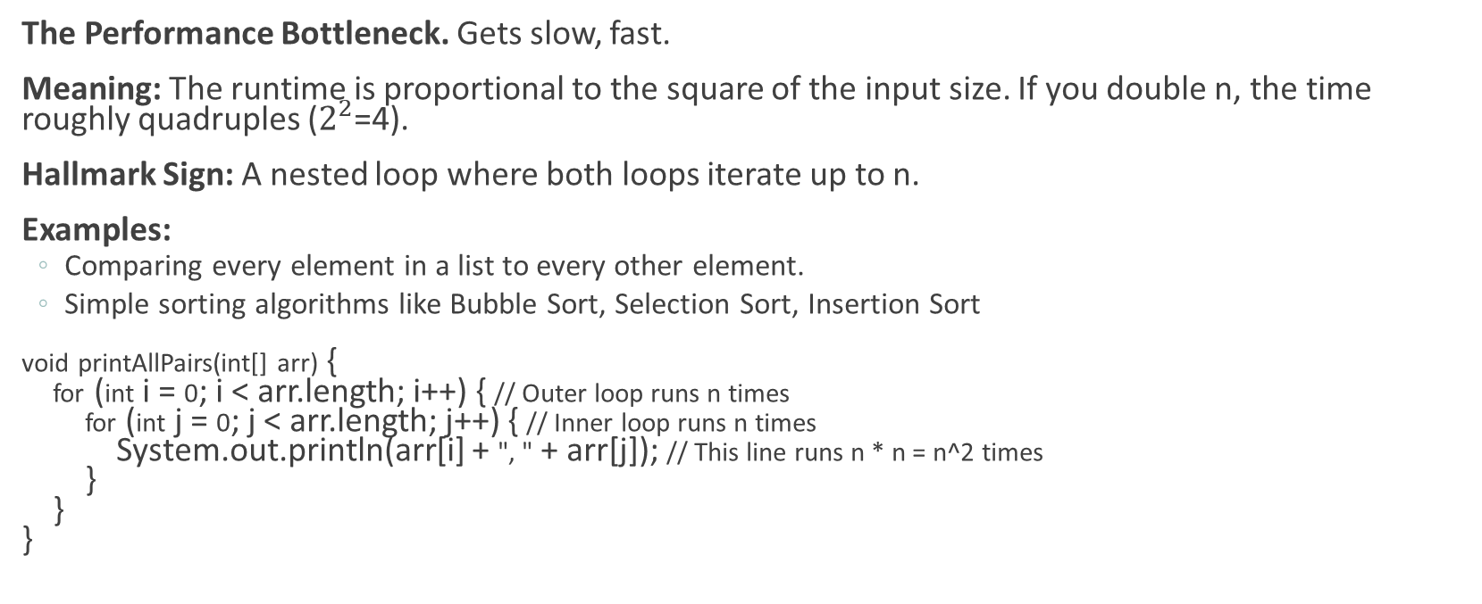
O(n²) - Quadratic Time
The Performance Bottleneck. Gets slow, fast.
Meaning: The runtime is proportional to the square of the input size. If you double n, the time roughly quadruples ($2^{2}$=4).
Hallmark Sign: A nested loop where both loops iterate up to n.
Examples:
Comparing every element in a list to every other element.
Simple sorting algorithms like Bubble Sort, Selection Sort, Insertion Sort
void printAllPairs(int[] arr) { for (int i = 0; i < arr.length; i++) { // Outer loop runs n times for (int j = 0; j < arr.length; j++) { // Inner loop runs n times System.out.println(arr[i] + ", " + arr[j]); // This line runs n * n = n^2 times } } }

Slide 18
(log n) - Logarithmic Time
The Superstar. Incredibly efficient and scalable.
Meaning: The runtime grows very slowly. Every time you double the input size n, the work only increases by one extra step.
Hallmark Sign: The algorithm repeatedly cuts the size of the problem in half.
Analogy: Guess the Number Game (1-100)
You don't guess 1, 2, 3... (That's O(n)).
You guess 50. "Too high." Now you only search 1-49.
You guess 25. "Too low." Now you only search 26-49.
You are halving the search space with each guess.
Prime Example: Binary Search in a sorted array.

Slide 19
O(n log n) - Log-Linear Time
Slide 18: O(n log n) - Log-Linear Time
The Sorting Champion. A very common and efficient complexity for complex problems.
Meaning: A combination of linear and logarithmic behavior. For each of the n items, you are doing roughly log n work.
Hallmark Sign: An algorithm that divides a problem into smaller pieces, solves them independently, and then combines the results. (Divide and Conquer).
Examples:
Efficient sorting algorithms: Merge Sort, Quick Sort (average case).
Many algorithms in computational geometry.

Slide 20
O(2ⁿ) - Exponential Time
The Villain. Avoid at all costs if n can be large.
Meaning: The runtime doubles with every single addition to the input size.
Becomes computationally infeasible extremely quickly.
For n=10, 210≈1,000
For n=20, 220≈1,000,000
For n=40, 240≈1,000,000,000,000 (a trillion!)
Example:
The naive recursive solution for Fibonacci numbers.
Trying every possible subset of a set of items (The Power Set).

Slide 21
Complexity Class Cheat Sheet
Big O | Name | Example | Scalability
O(1) | Constant | Array lookup arr[i] | Excellent
O(log n) | Logarithmic | Binary Search | Excellent
O(n) | Linear | Finding max value in an array | Good
O(n log n) | Log-Linear | Merge Sort | Good
O(n²) | Quadratic | Bubble Sort, nested loops | Poor
O(2ⁿ) | Exponential | Recursive Fibonacci, Power Set | Awful
O(n!) | Factorial | Traveling Salesman (brute force) | Don't even.

Slide 22
Best, Average, and Worst Case
Sometimes an algorithm's performance depends on the input data itself.
Let's consider searching for an item in an array:
Best Case: The item is the very first element. This is O(1). We use Big Omega (Ω) to denote the best-case lower bound.
Worst Case: The item is the very last element, or not in the array at all. We have to check all n elements. This is O(n). We use Big O (O) for the worst-case upper bound.
Average Case: The item is somewhere in the middle. This is also O(n). We use Big Theta (Θ) to describe the average or tight bound.
Why do we usually care most about the Worst Case (Big O)?
It gives us a guarantee. We know our program will never perform worse than our Big O analysis suggests. It's crucial for mission-critical systems.

Slide 23
Let's Analyze Some Code!
What's the Big O of this function?
void mysteryFunction1(int n) { int a = 5; int b = 10; for (int i = 0; i < n; i++) { int x = i * 2; int y = x + a; } }
Answer: Since the loop runs n times, and the work inside it is a constant amount, the total complexity is linear, or O(n).

Slide 24
Code Analysis 2
What about this one?
void mysteryFunction2(int n) { for (int i = 0; i < n; i += 2) { System.out.println(i); } }
Answer: The loop runs n/2 times. We drop the constant (1/2), so the complexity is still O(n).

Slide 25
Code Analysis 3
And this one?
void mysteryFunction3(int n) { for (int i = 1; i < n; i = i * 2) { System.out.println(i); } }
Answer: Tricky! i goes 1, 2, 4, 8, 16... it doubles each time. This is the hallmark of a logarithmic pattern. The complexity is O(logn).

Slide 26
Summary
We measure algorithm efficiency by counting operations as a function of input size n, not by timing it.
Asymptotic analysis focuses on the growth rate for large n.
Big O notation gives us a formal language to describe the worst-case performance of an algorithm.
We can analyze code (especially loops) to determine its Big O complexity.
This knowledge is essential for choosing the right data structures and building scalable, high-performance software.

